Slide 1
Welcome to Persuasion: COM 318
Dr. Susan E. Morgan
Professor
Brian Lamb School of Communication

Slide 2
Today’s Class
Who are your instructors? Who’s YOUR TA?
What are the goals of the class?
Do you have to buy the books?
How many exams? Is there a paper?
Is attendance required?
What’s the policy on using computers & phones in class?
How can I get extra credit?
How can I be sure to get a good grade?
Syllabus quiz (5 points): September 3rd.

Slide 3
Your Instructors
Brooke Friley: Last names A-G
Kurtis Miller: Last names H-O
Megan Peter: Last names P-Z
Dr. Susan Morgan (Professor): Everyone

Slide 4
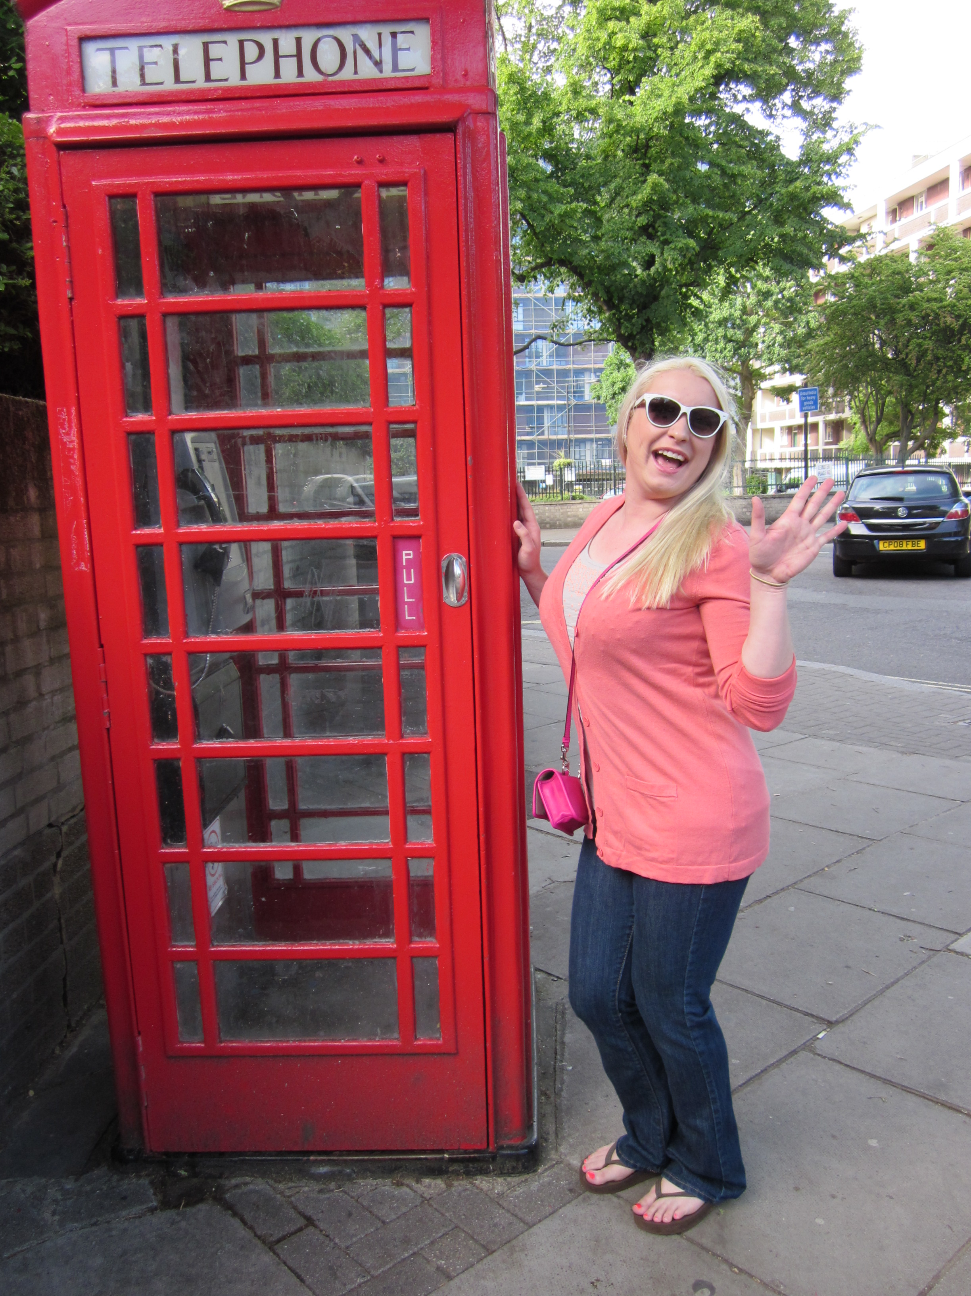
Brooke Friley (last names A – G)
Education
-B.A. in Communication from University of Louisville
-M.A. in Communication from University of Louisville
-3rd year PhD in Communication (Health Com focus)
Research Interests
-Health Campaigns
-Physician-Patient Communication
-Persuasion and Social Influence related to health behaviors
Fun Facts
-Have 2 cats: Prada and Versace
-Previously worked as an event manager for children’s birthday parties
-Love to cook, especially Southern-style food!

Slide 5
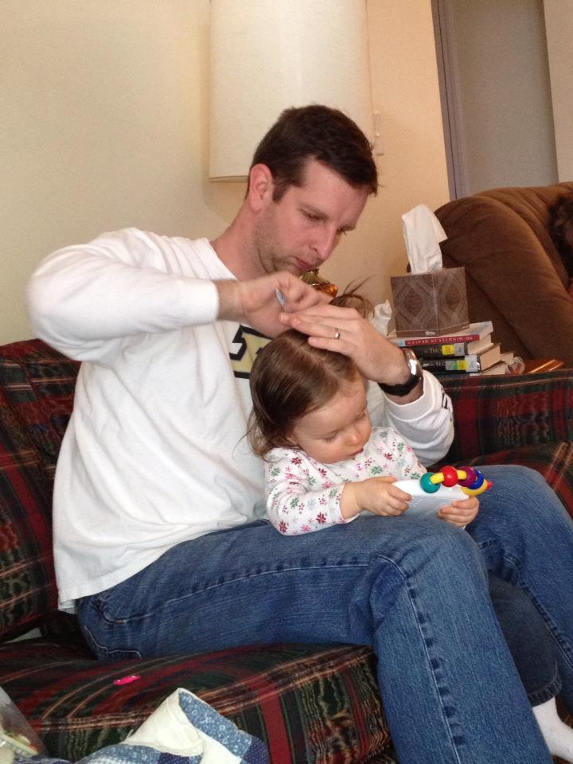
Kurtis D. Miller (last names H – O)
Education
B.A. Communication: Speech/Theatre
Anderson University (Anderson, SC)
M.A. Communication
College of Charleston
A little over halfway to my Ph.D. in Communication
Research Interests
Small Groups
Group Decision Making
Language Use
Fun Facts
My family runs a century farm in Iowa
Infantry Officer in the US Army
(Afghanistan, 2007-2008)
I have two kids!
Gwendolyn (2 years)
Jacob (4 months)
I always win “Two Truths and a Lie”

Slide 6
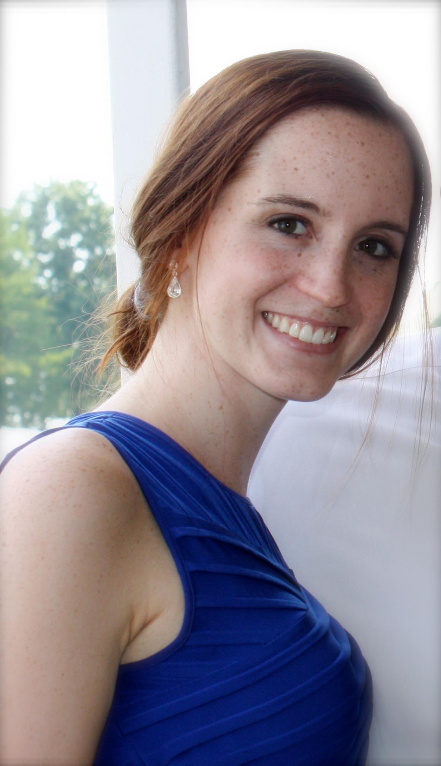
Megan Peter (last names P-Z)
Education
B.A. Communication, Michigan State University
Second year of M.A. in Communication
Research Interests
Health campaign design
Quantitative research methods
Comparative healthcare policy
Fun Facts
Has a twin sister
Lived in Spain for a semester
Speaks (a little) Chinese

Slide 7
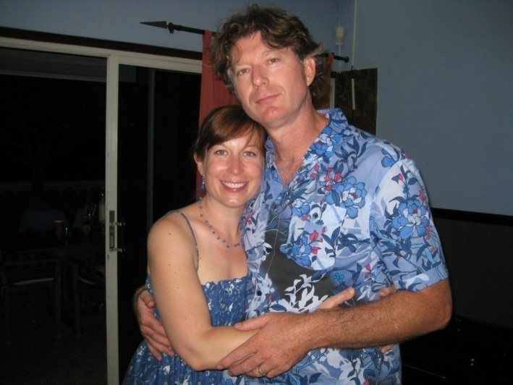
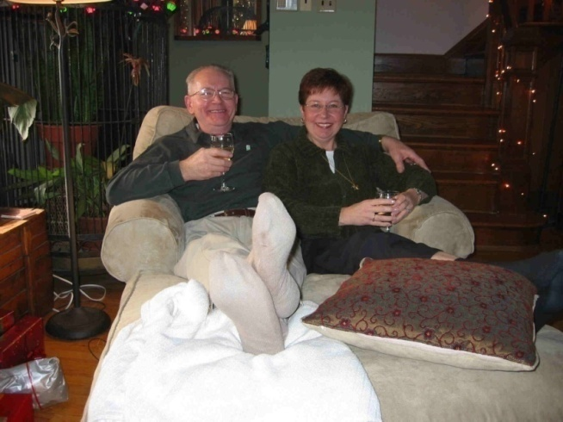
Dr. Susan E. Morgan (Your Professor)
Education/Background
B.A. Communication, U of Massachusetts; MA & Ph.D., U of Arizona.
Professor, Purdue (2005- present)
Research Interests
The design and evaluation of health campaigns
Intercultural communication
Fun Facts
$9+M in federally funding, 50 publications, 1 book, 50 conference papers and presentations… and yet watches America’s Next Top Model.
Is married to Dr. Harrison but is neither Mrs. Harrison nor Mrs. Morgan!
Is glad her father changed their last name from “Mochnacs” but is still close to her Hungarian family.

Slide 8
Who Should You Email?
Email your TA with questions about grades, lecture materials/outlines, exams, assignment requirements, attendance.
Email Dr. Morgan to make an appointment to discuss questions about lecture content, theories of persuasion, problems with your TA, career aspirations & trajectories, coursework strategies to attain career goals, cool and interesting thoughts and ideas.

Slide 9
Goals of the Class
1. To learn about the major areas of study in the field of persuasion.
2. To provide opportunities for the analysis of persuasive techniques.
3. To understand how theories of persuasion can aid the comprehension of everyday circumstances.

Slide 10
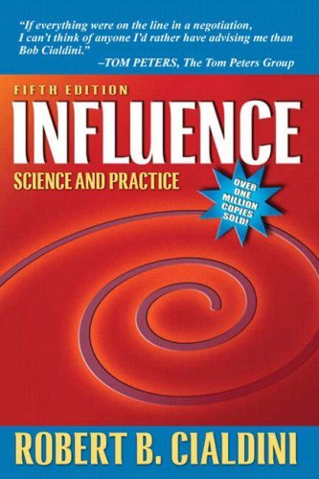

Do You Have to Buy the Books?
Only if you want to do well!
Cialdini, R. B. (2009). Influence: Science and Practice, 5th Edition. New York: Harper Collins.
Gass, R.H. & Seiter, J.S. (2013). Persuasion, Social Influence, and Compliance Gaining, 5th Edition. Allyn & Bacon. You can also use the 4th edition. Text is available in e-format as well as print.
These text books are REQUIRED for this course. For both books, test questions and lectures will focus on material contained in these specific editions of each book. We do not have access to information about changes to the texts from editions prior to the 4th edition of G&S.

Slide 11
What are the Major Requirements?
Three (non-cumulative) exams (100 points each). Lowest score will be dropped.
Mini-paper (50 points)
Activities and civility (50 points)
Total of 300 course points

Slide 12
Is Attendance Required?
No.
Benefits of coming to class:
Material covered in class (but not necessarily in the book) will be on the exam.
Exam will include questions on video examples.
Lecture will help you understand the material.
If you attend class:
No technology in the classroom: No use of laptops, phones, etc. PowerPoint lectures available 24 hours in advance.
Violation of technology policy will result in a grade penalty (1/2 letter grade). No “warnings.”

Slide 13
What are the exams like?
3 exams. Your top 2 scores count.
33- 50 multiple choice questions
No make-up exams, even for really, really, really good reasons.
If you miss two exams, you must have verification from the Dean of Students’ Office that BOTH were documented emergencies in order to make up ONE of the exams.

Slide 14
Is There a Paper?
One mini-paper
3-4 pages
You will review one theory and then show how you have seen it in action in your life.
Please complete the assignment early and take to the writing center for help if you are not already a strong writer or if you are not used to writing papers.
Submit your paper via Blackboard AND SafeAssign

Slide 15
Can You Get Extra Credit?
Yes, but you should do it early to make sure you can get in.
Please review the instructions before you sign up for studies. To view the instructions go to http://www.cla.purdue.edu/communication/undergraduate/rps.shtml
You can sign up to participate in studies by logging in to http://purdue-comm.sona-systems.com/
We will be automatically notified at the end of the semester of who has participated.
Extra credit is not a right. If you fail to follow instructions or you wait too long to participate in a study, please do not complain.

Slide 16
How Can I Get a Good Grade?
Come to class (unless you are very ill) and pay attention. Participate in discussion. Take good notes.
Keep up with course readings. Have the assigned readings done BEFORE class.
Study hard for ALL of the exams. Have a study partner who is also a serious student.
Be professional and civil in all of your communication with your fellow students, me, and the TAs. Don’t violate the tech policy.
Go to the writing center in advance of the paper deadline for help with organization, editing, proofreading, and general writing. Follow all of the criteria for the paper requirements to the letter. Talk to your TA if you don’t understand any part of the assignment.
Take advantage of the extra credit research opportunities well in advance of the end of the semester.
Communication classes aren’t “easy” classes. Work hard!

